Slide 1
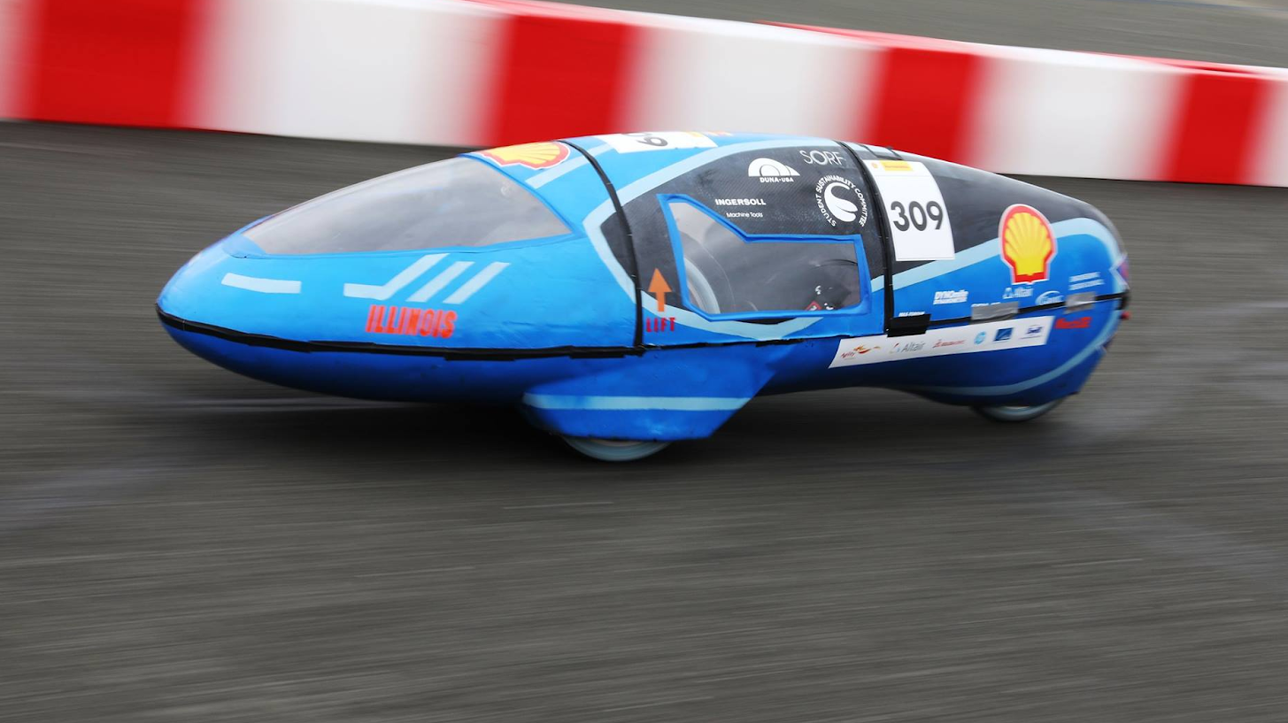

Eco Illini Supermileage
Week:
3/23/2020

Slide 2
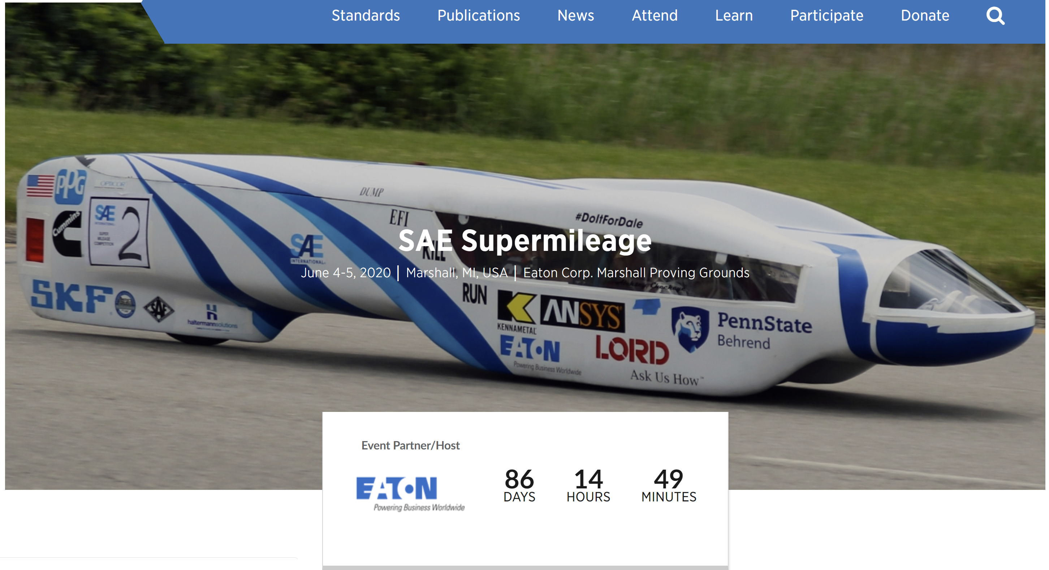
Registration and Administration
Shell 2020
  Cancelled, but "Virtual" ?
  No update
  Pursuing funds not give to us from last year
SAE 2020
  Gone Virtual
  Points based off design report and virtual presentation
  Design Report due by March 30th

Slide 3
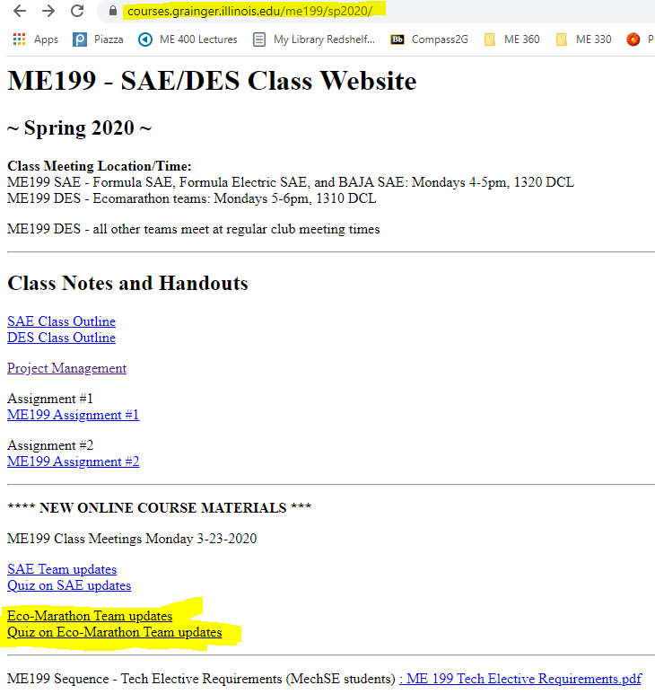
ME 199 and Class Participation
In-class participation suspended
Meetings temporarily on hold
Course Evaluation: (How we will evaluate/give you a grade)
Participation on projects/planning through the rest of SP 2020
Completed CAD Assemblies of projects
  Email skamzol2@Illinois.edu for Solidworks
  If unable to run, see below
Team Wiki:
  Post project work, information/research, methods towards completing your project, and status of project → Why did you do what you did???
  List where future development could be made (if any)
Paper: Write conclusion of where project is left at, steps needed to finish it, and rough time needed to assemble/test
Attendance: Take “Quiz”; based on these PPT’s!

Slide 4
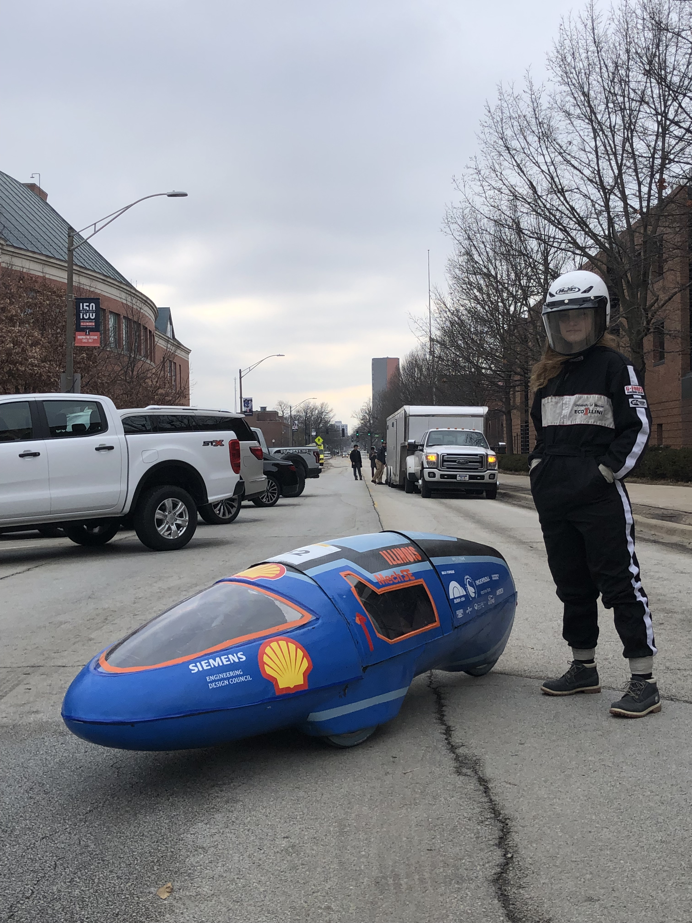
Timeline
Technical work:
SAE Design Report due 30th -- ESSENTIAL
Rest is largely based upon stay-at-home order and accessibility to ESPL
Offline Work
Have full assemblies with electronics by end of semester
Wiki:
  Project pages for new members, process diagrams for leads
Quad Day materials and posters: get ready now
Plan out goals for 1st month activities, member retainment

Slide 5

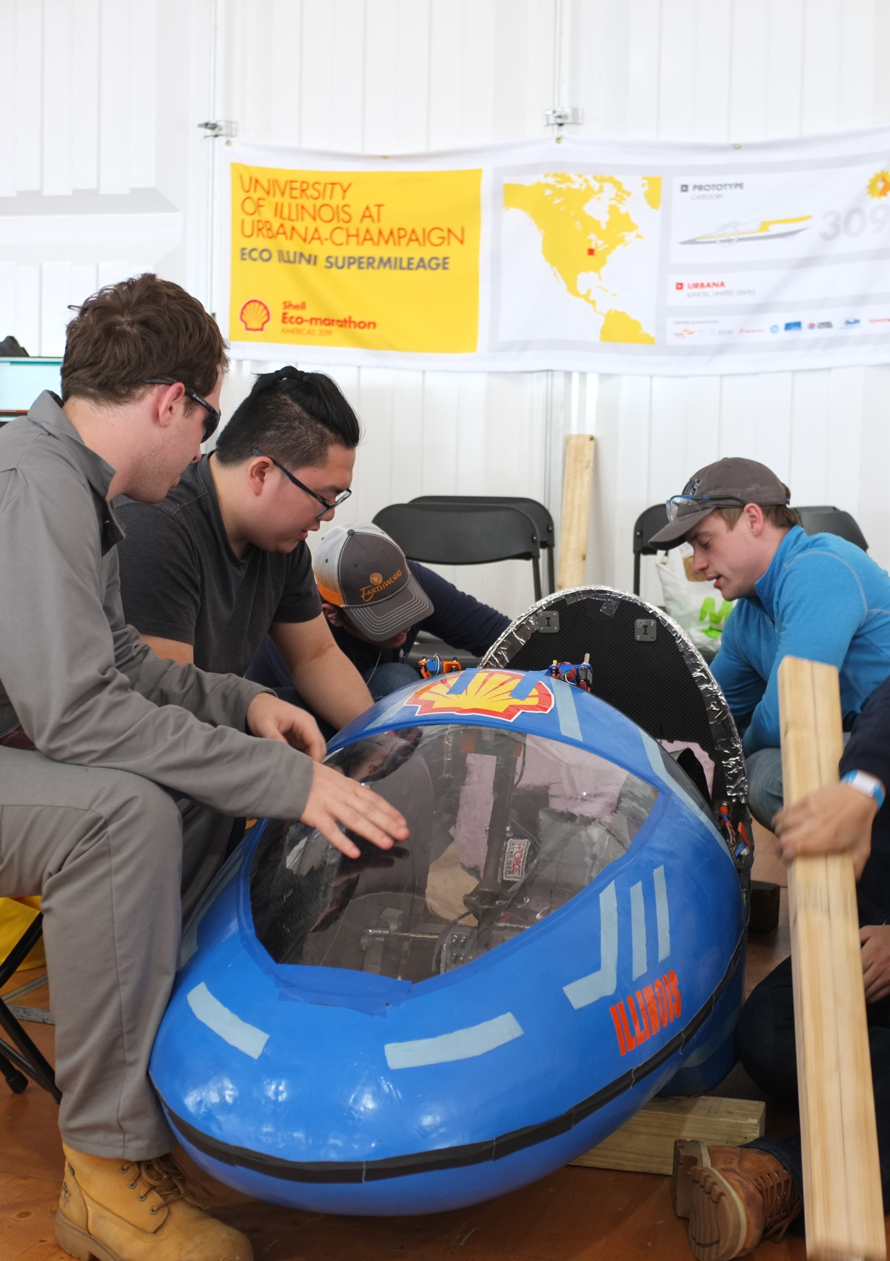
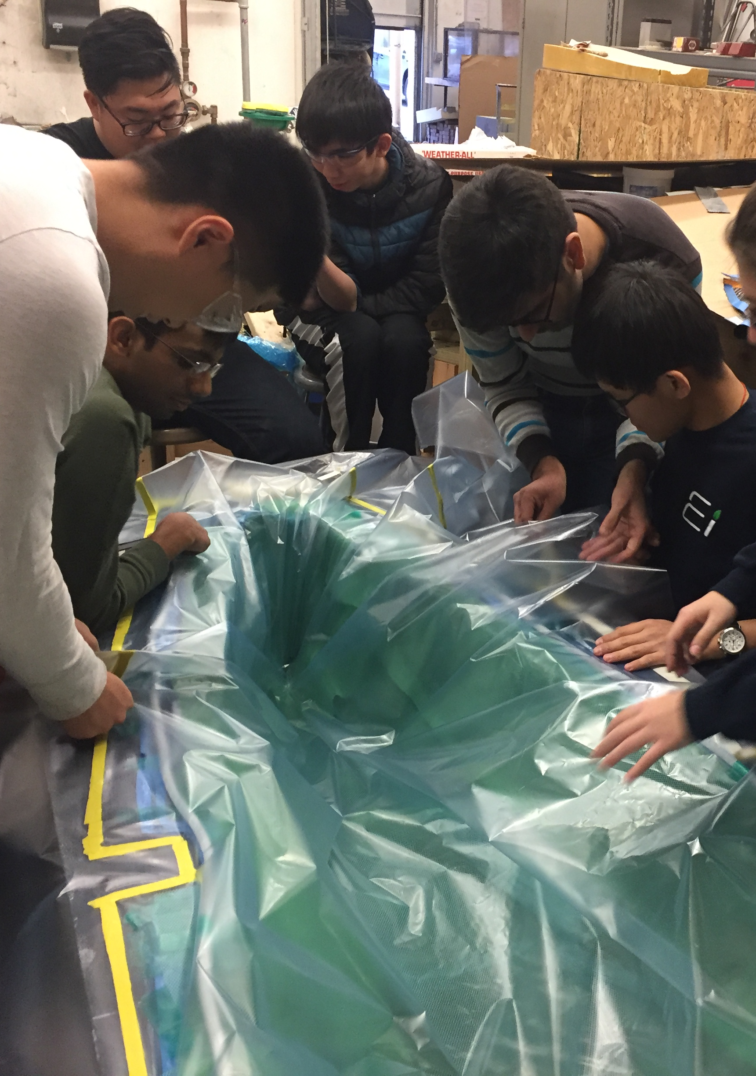
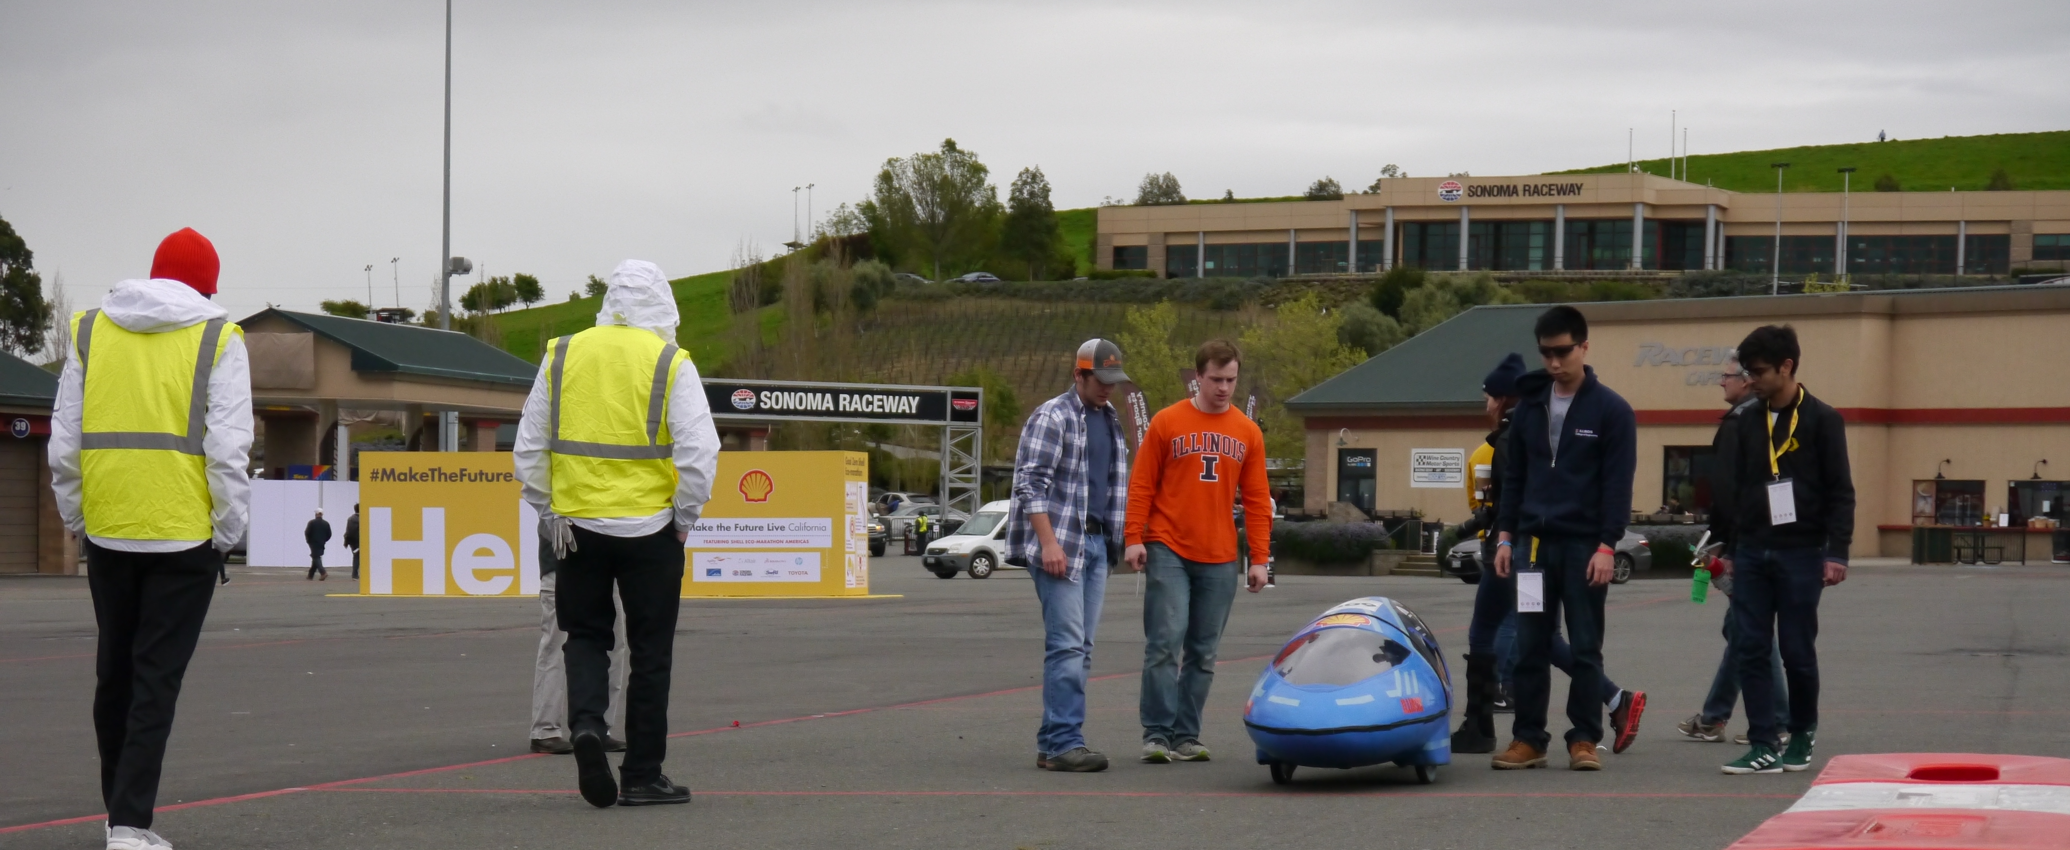
Mechanical

Slide 6
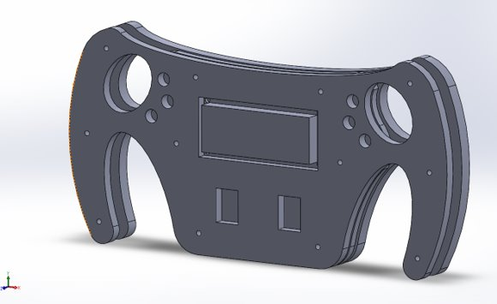
Mechanical
Engine assembles, would run if had access to ESPL
Working on assemblies

Slide 7
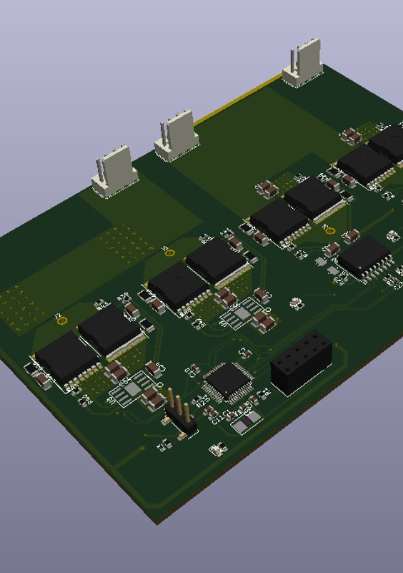
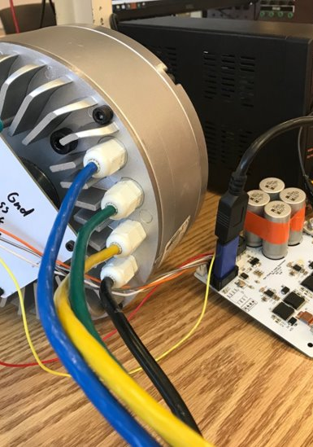
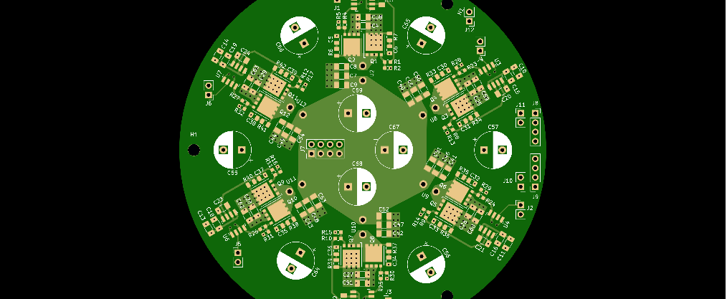
Electrical

Slide 8
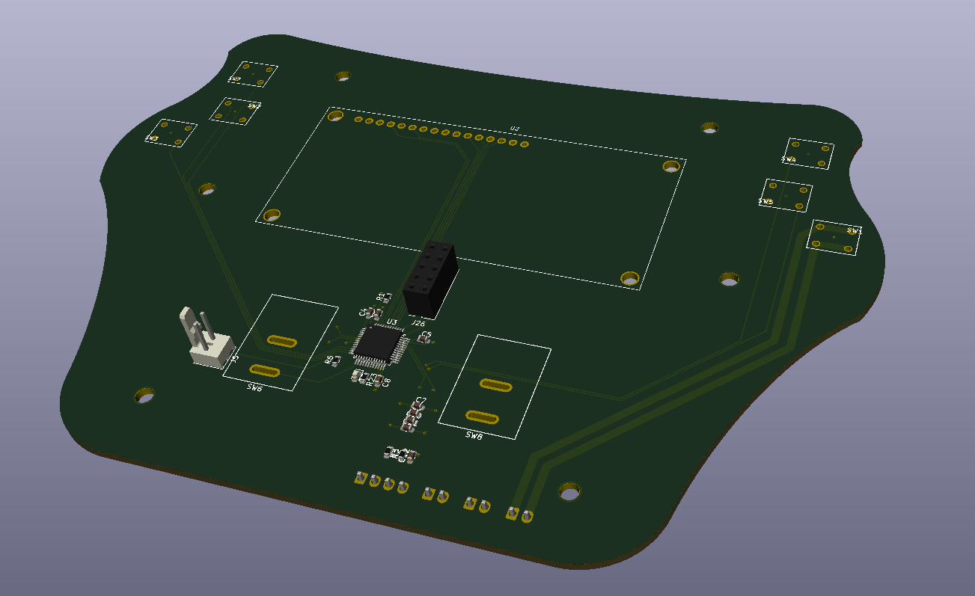
Electrical
Shifting gears from electrical to gas for SAE
Battery has been manufactured
Working on steering wheel pcb design
Working on motor mounting issues
Moving back to shelved projects

Slide 9
Body

Slide 10
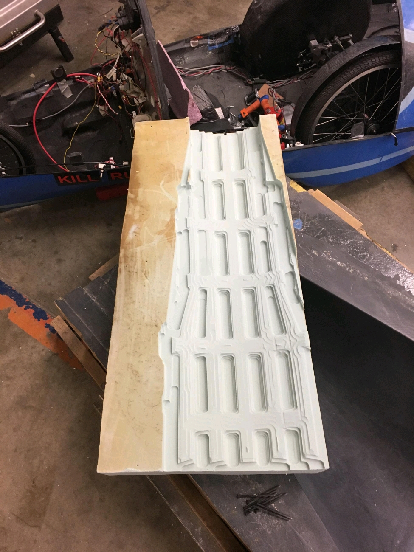
Body Projects
Front truss layup done
Aircore ready for VARTM
1-1.5 weeks away from rolling car pending ESPL opening

Slide 11
Aero

Slide 12
Aero Projects
Get Ansys license
Working on Ansys simulations from home, results will be shared!

Slide 13
Manufacturing

Slide 14
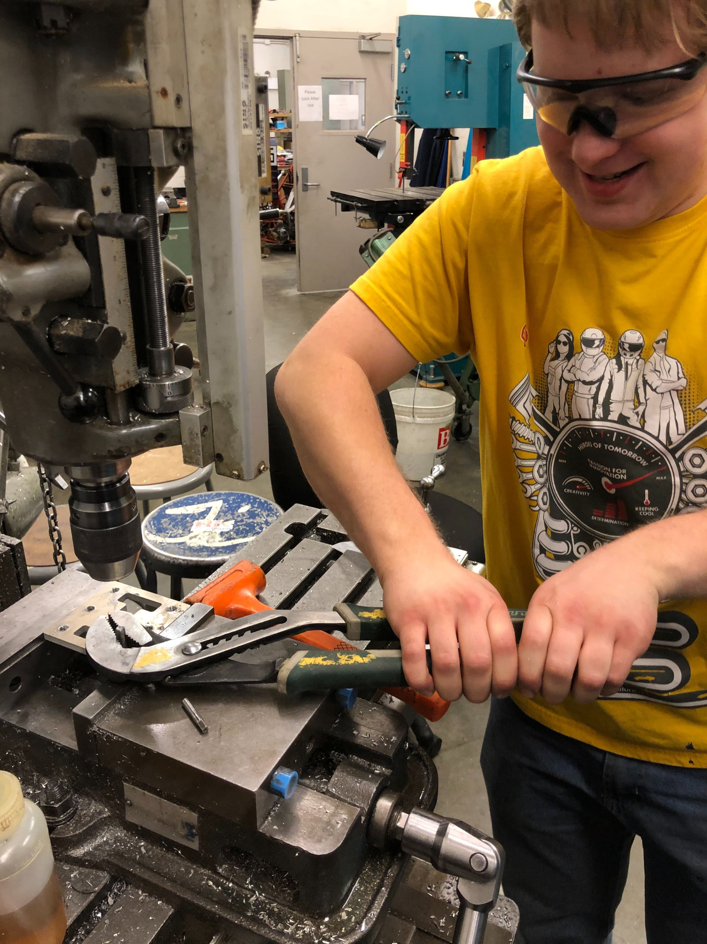
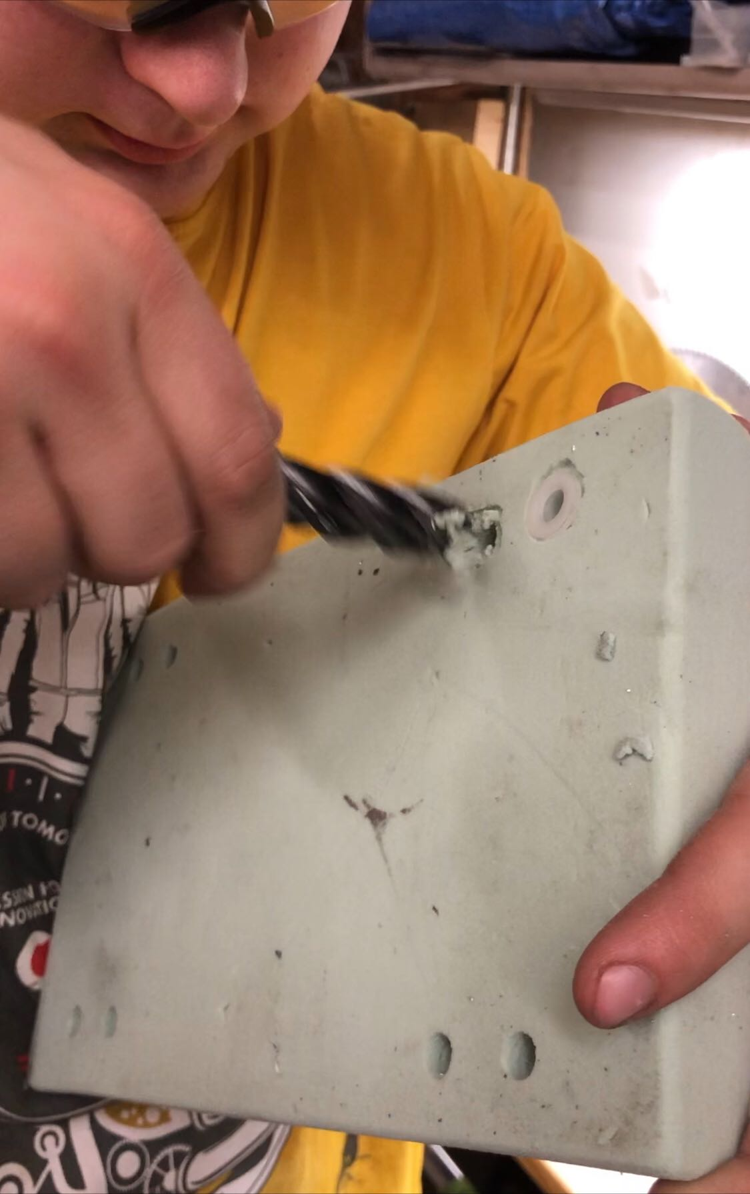
Progress
Waterjet – 100% (??)
Machining: ~85% complete
Welding: ~50% complete
Highlights
  Rolling car ready

Slide 15
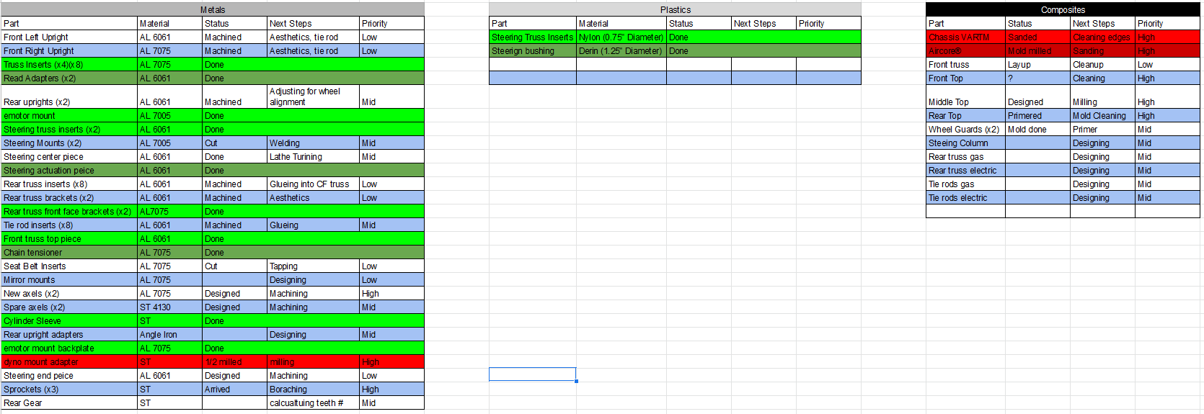
Manufacturing

Slide 16


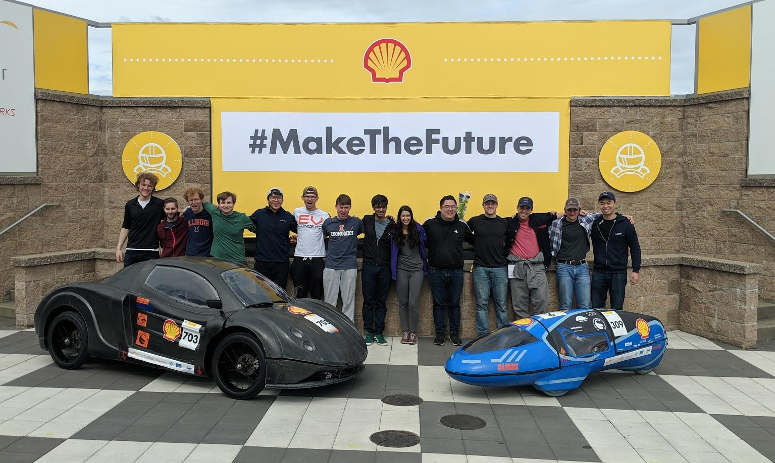


Slide 17
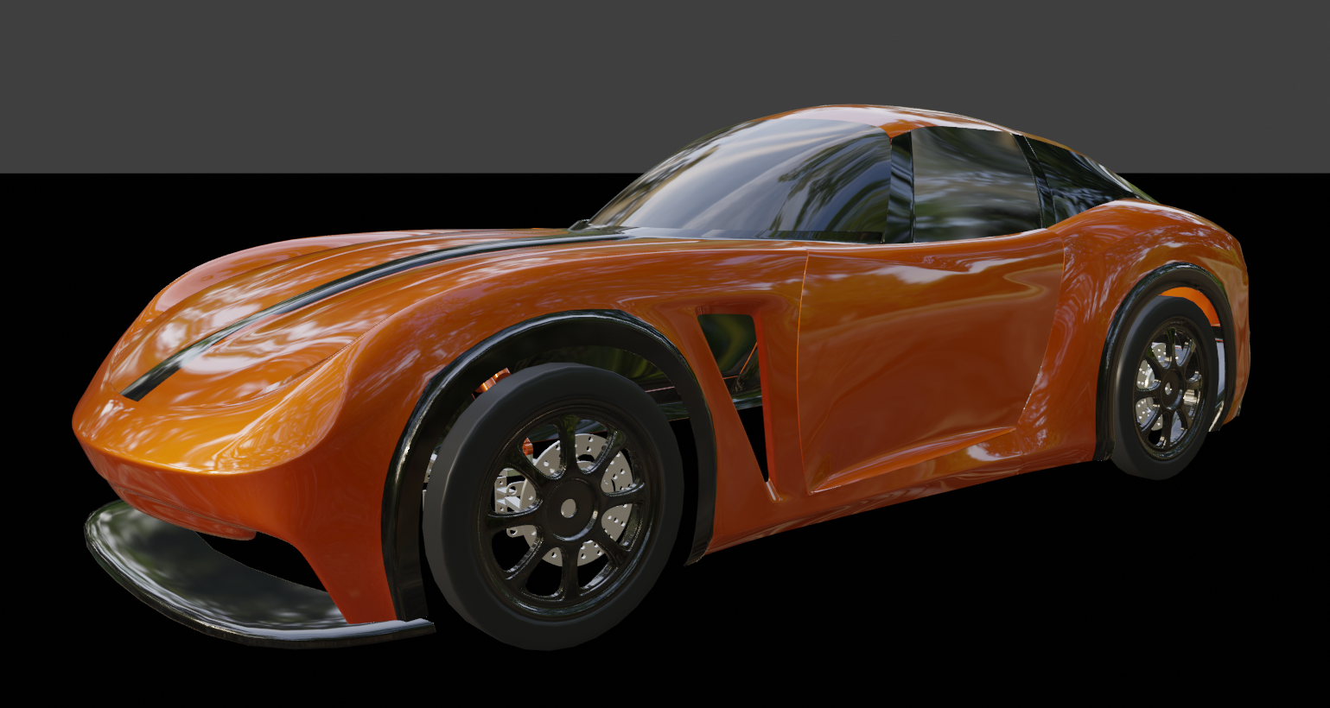
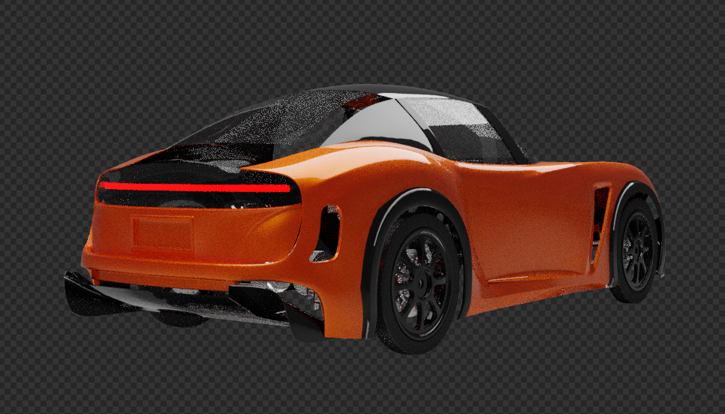
Administrative - Robert Mauge
School cancelled
Virtual meetings
  CAD workshops
  Design workshops
  Design work for EV3

Slide 18
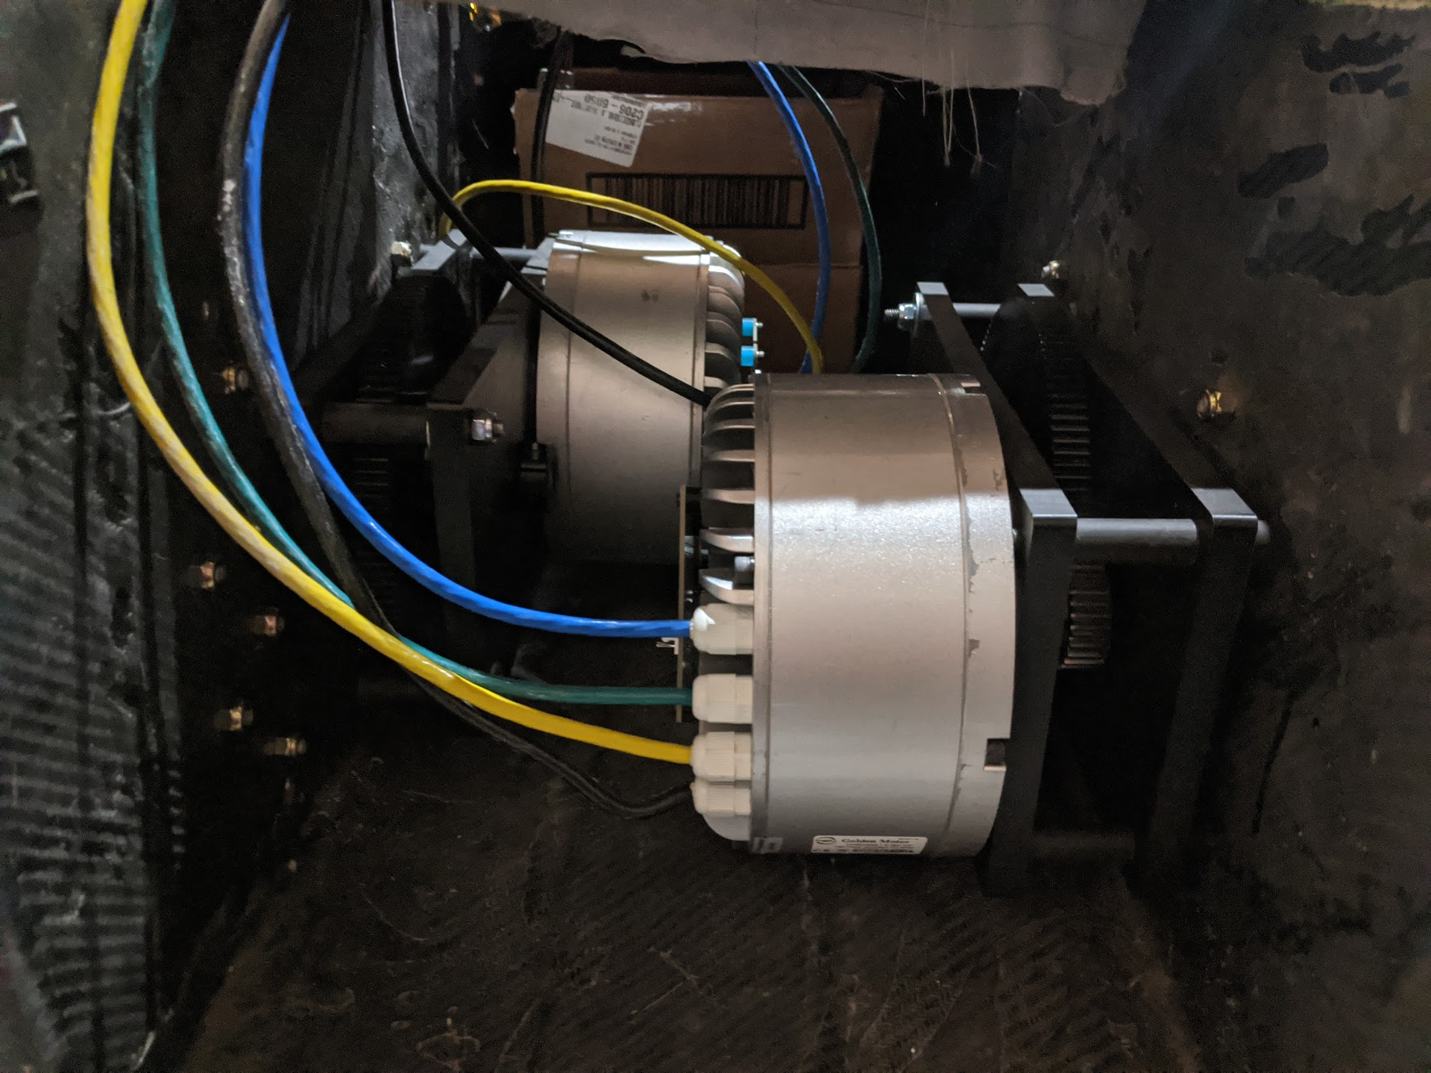
Mechanical Team - Robert Mauge

Slide 19
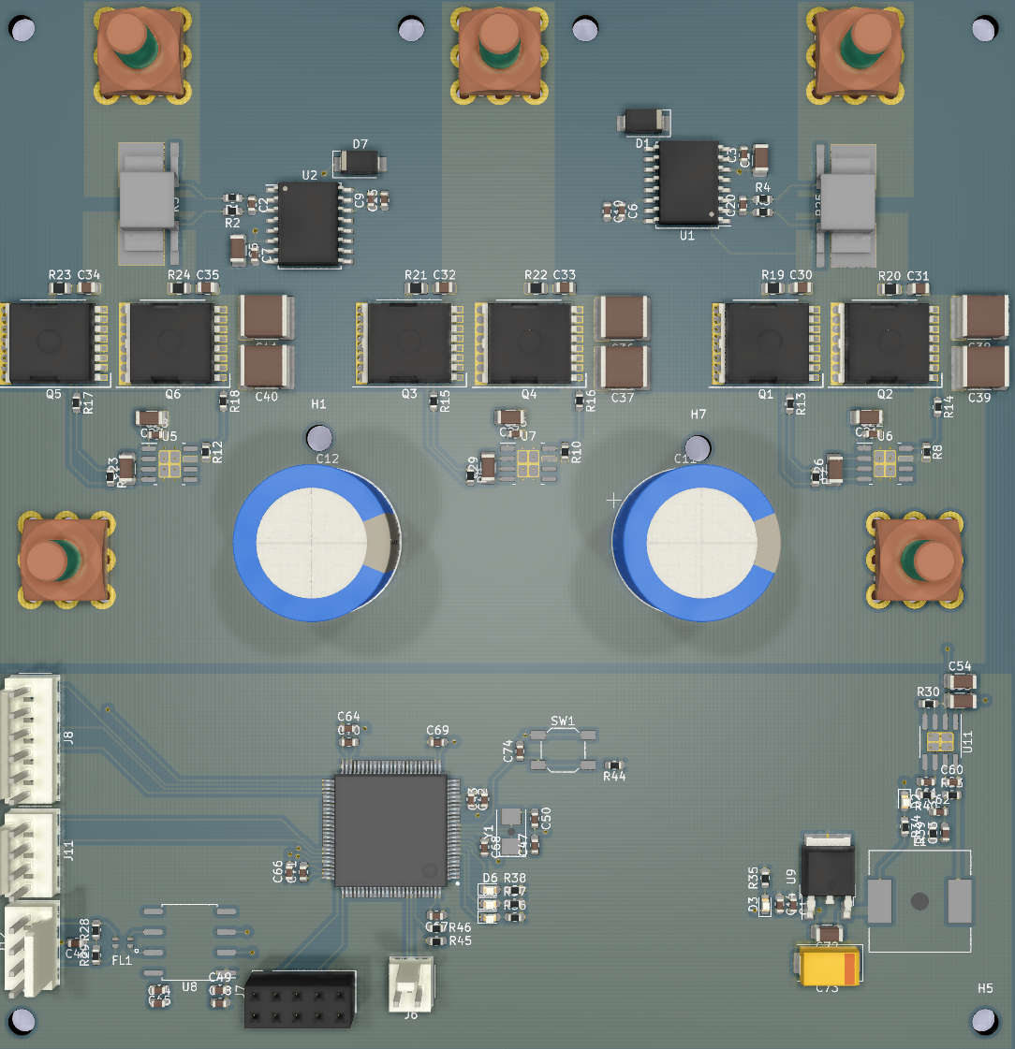
Electronics Team - Moving the Car
Changing Focus from driving to next year
  Redesigning the motor controller
    Easier to manufacture (less parts and easier to solder packages)
    New layout for improve efficiency
    Cheaper current sense option (May require more complex software to support)
    JLC can assemble 80% of the board
  Looking to GanFET tech for improved eff for low current power electronics
  Looking into ways to remote electronics meetings in a meaningful way
    Remote work- Too much logistics and lack of equipment
    Training videos or video calls- acts a way to pass on info and maintains engagement with students

Slide 20
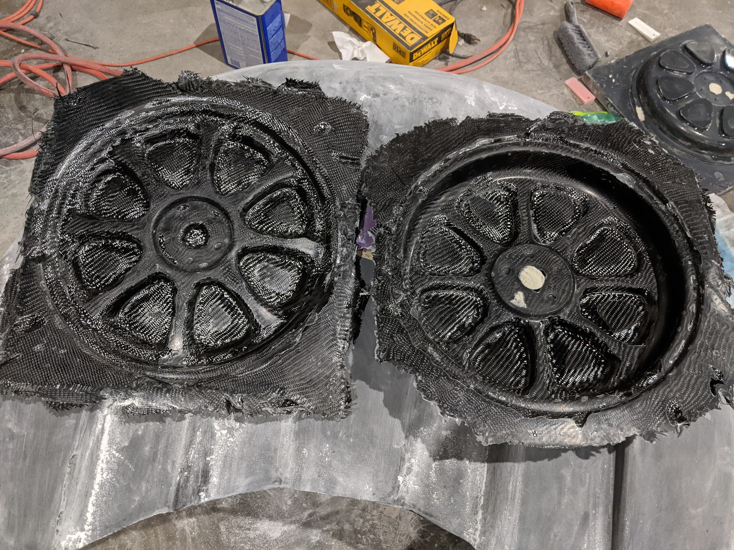
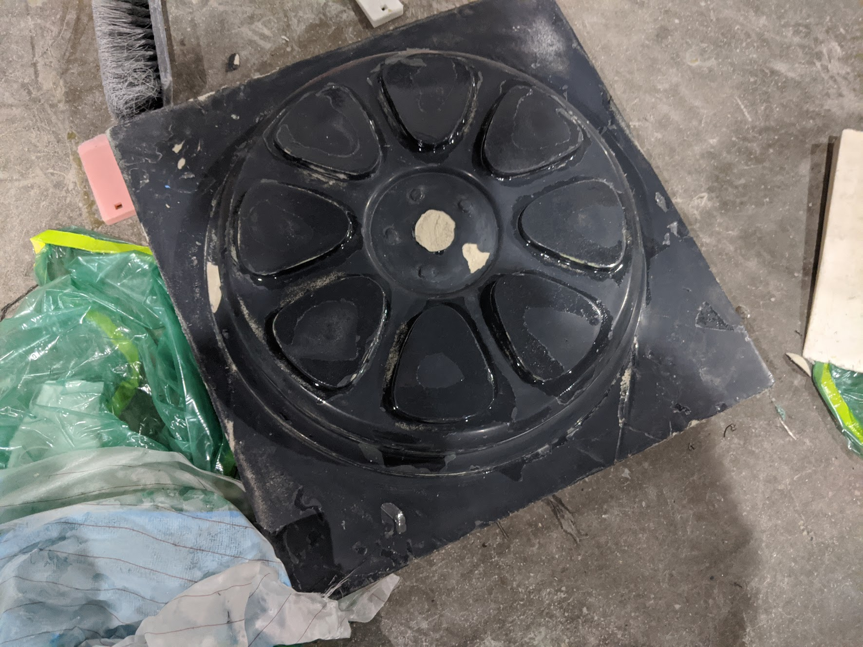
Composites Team - Richard Mauge

Slide 21
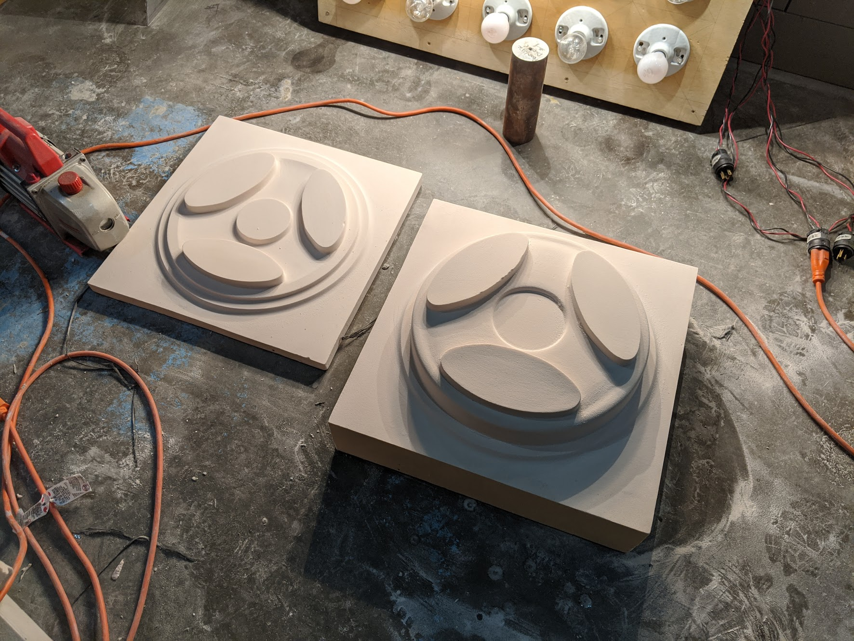
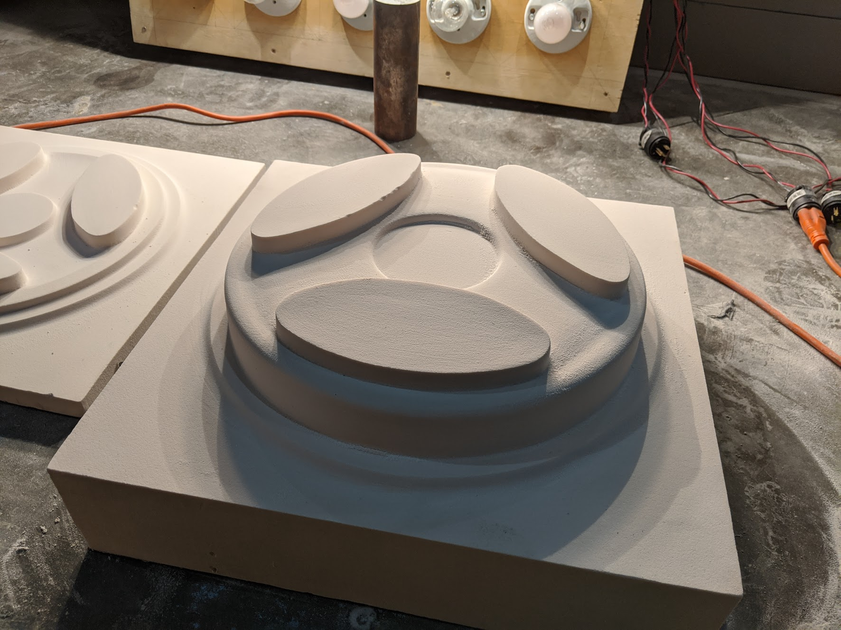
Composites Team - Richard Mauge

